Slide 1
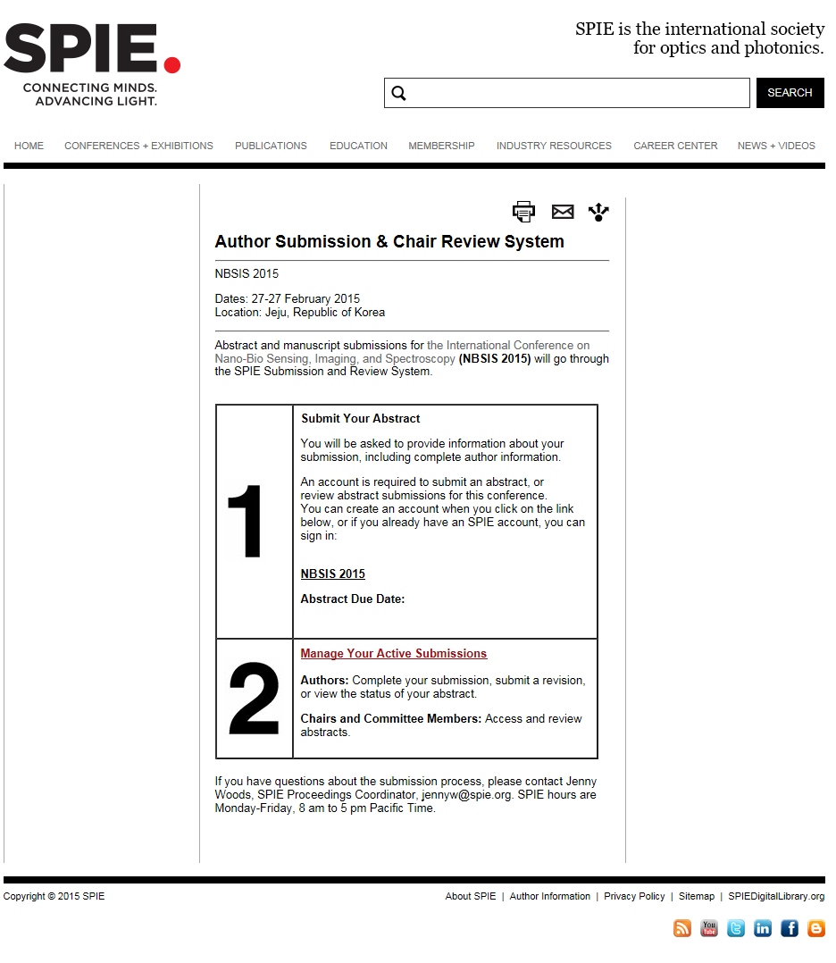
Abstract Submission Page
- http://spie.org/x111005.xml
Click

Slide 2
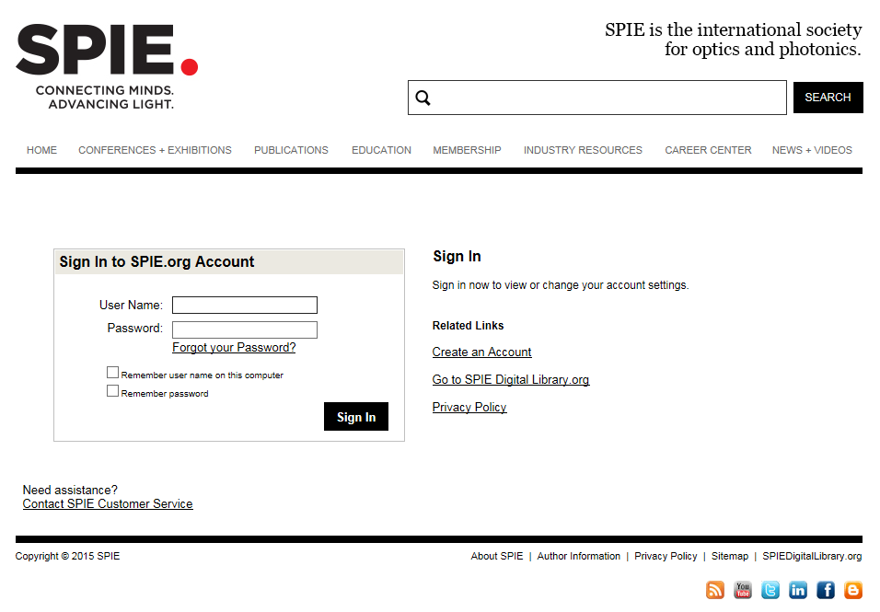
Log-in
If you are a member -> log-in
If you are not a member -> create an account

Slide 3
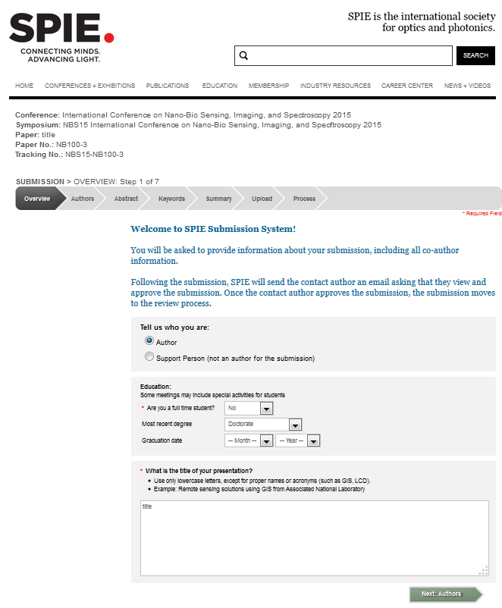
Overview
Student or not
Title
Click

Slide 4
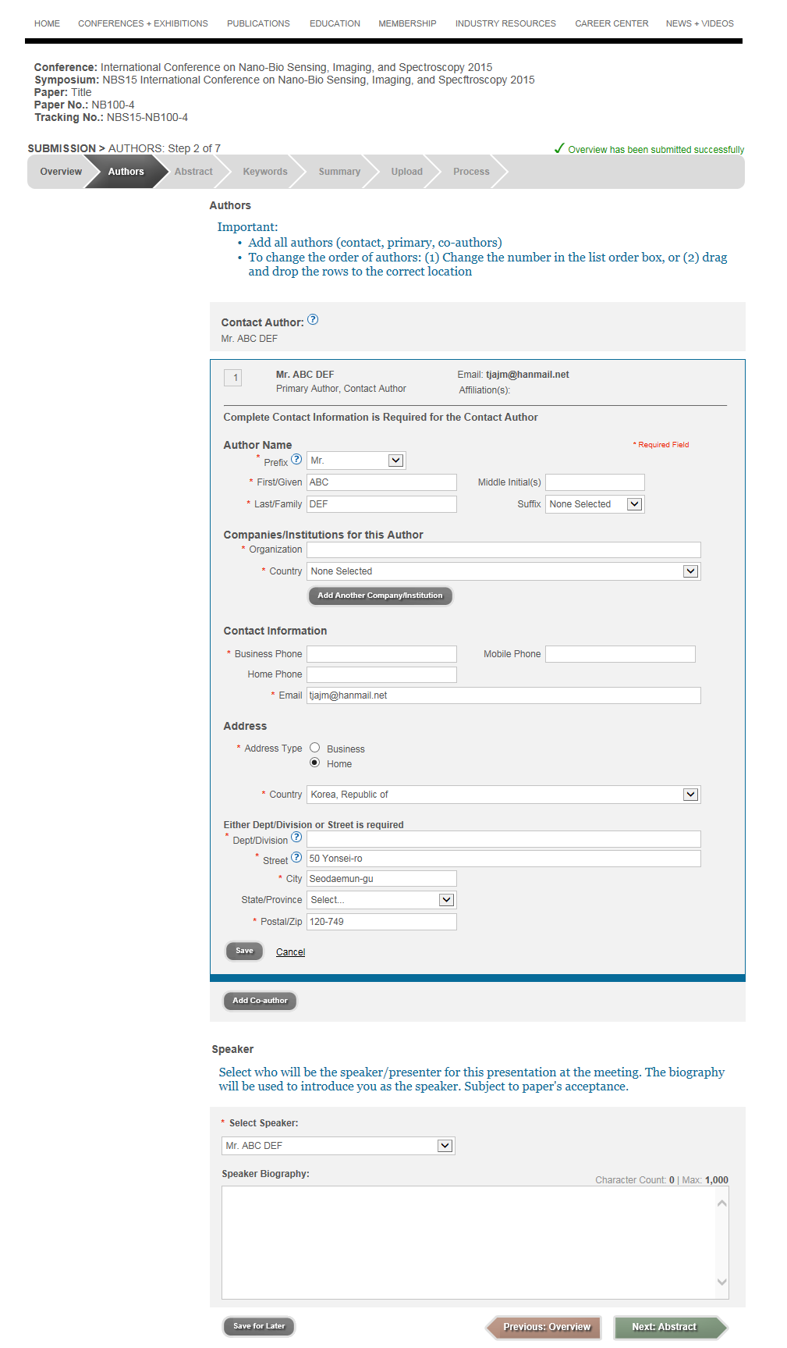
Authors
Enter the information
-> Click Save

Slide 5
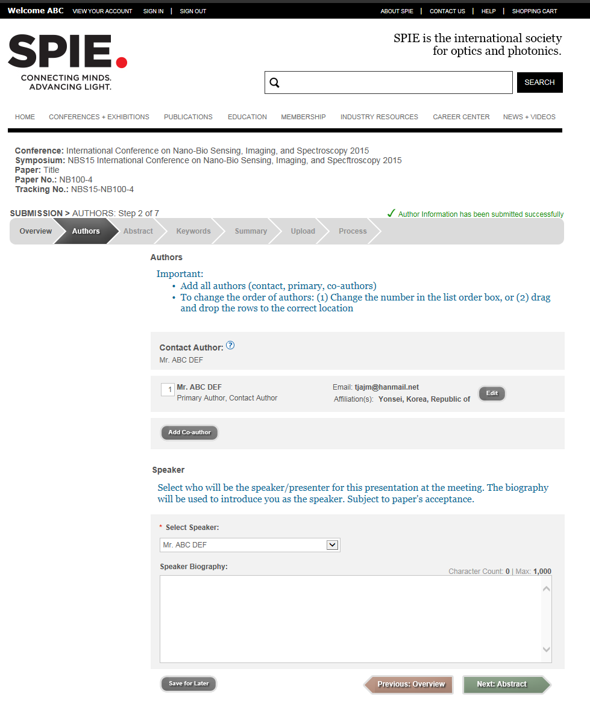
Authors
Add co-Author
Click

Slide 6
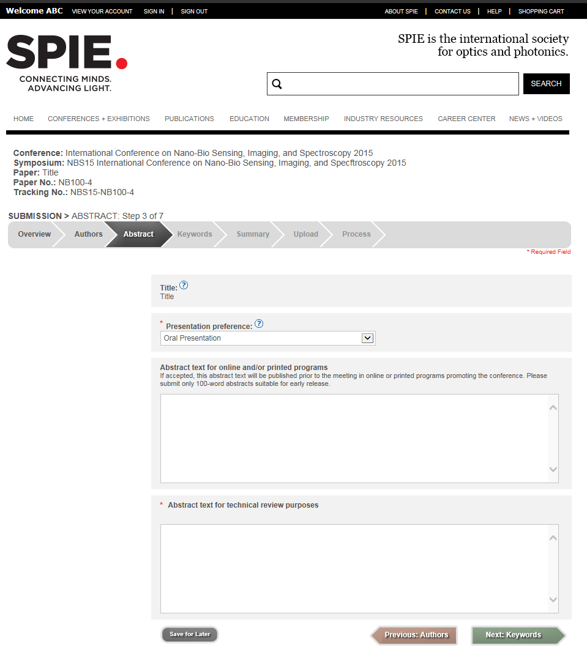
Abstract
Presentation type
100-words Abstract
Abstract for Technical Review
Click

Slide 7
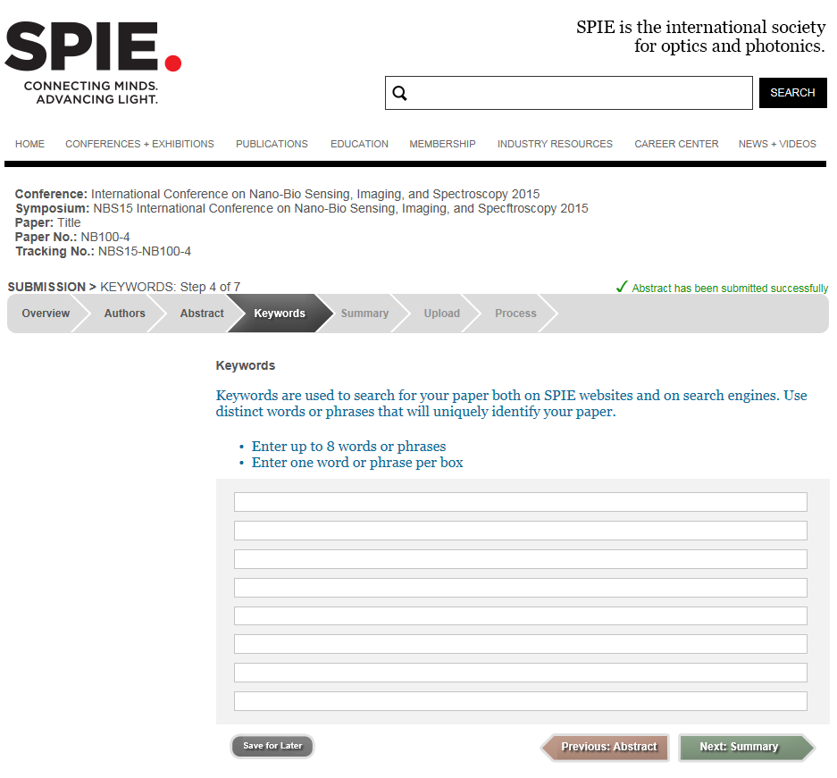
Keywords
Keywords
Click

Slide 8
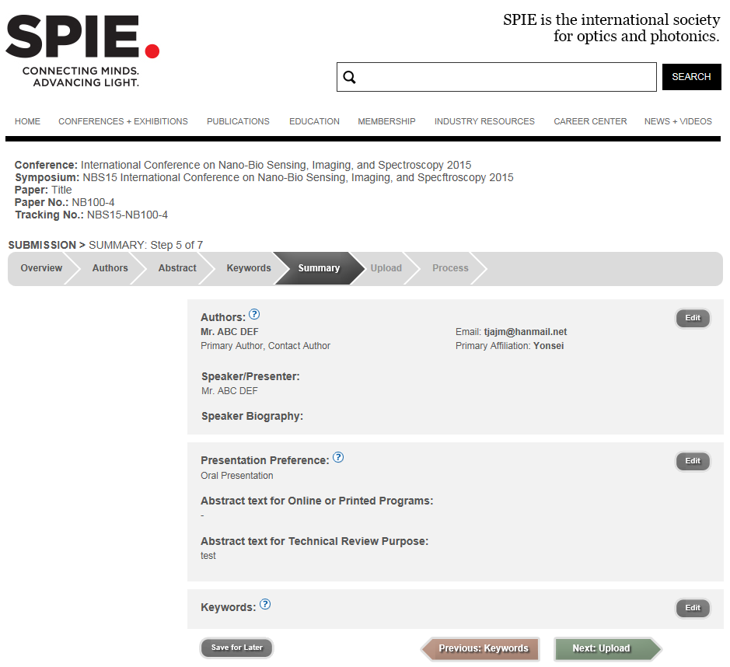
Summary
Check the information
-> Click

Slide 9
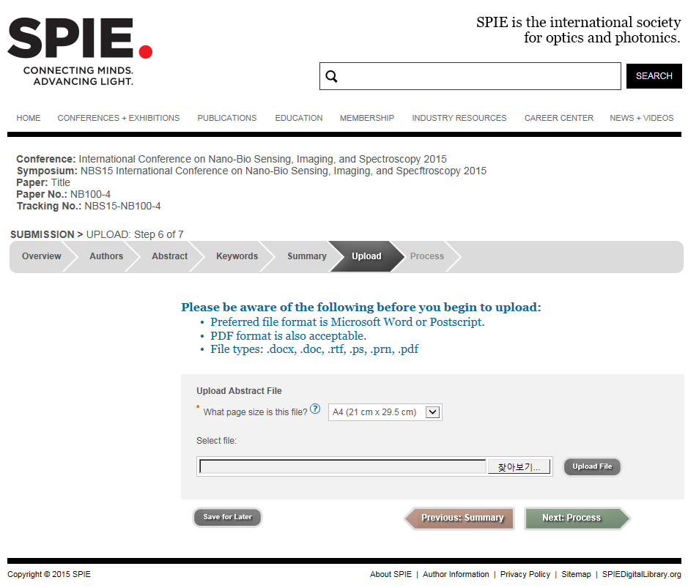
Upload
Select A4
Click
You can submit the abstract without uploading a file. The submission is completed when you click the “Next: Process”

Slide 10
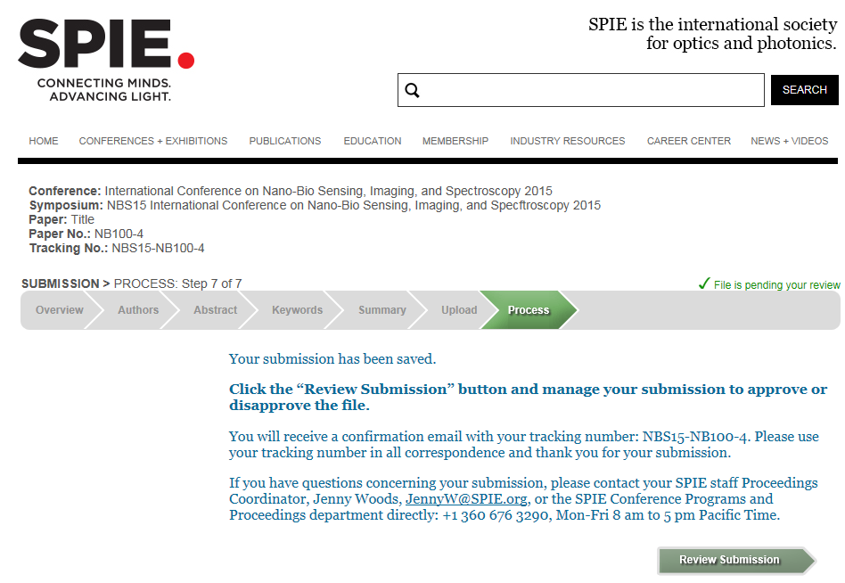
Process
Submission revision

Slide 11
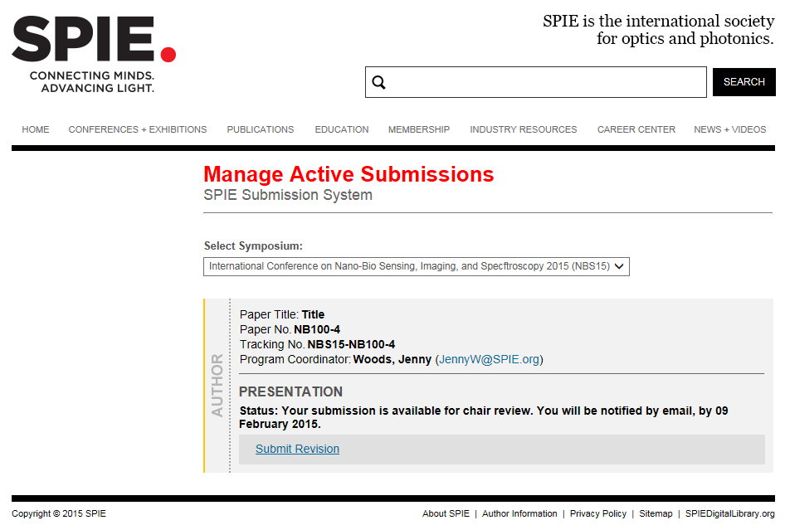
Submission Revision
Submission revision

